Slide 1
Bonding And Structure
Presentation by:
Ghalya Zainab

Slide 2
Bonding And Structure
The way in which atoms join together And combine with one Another.
The arrangement of the particles resulting from bonding is called a structure.

Slide 3
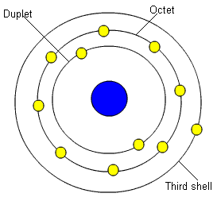
Conditions for bonding
Only valence electrons take part in the bonding.
The aim is to achieve noble
gas configuration.
Duplet=2 electrons
Octet=8 electrons
3rd shell=18 electrons

Slide 4
Formation of ions
Ionic
BOND
IONS :
These are charged particles held by strong electrostatic forces of attraction
formed when a metal gives away valence electrons to a non-metal.
The transfer of electrons helps both atoms to gain noble gas configuration.
Oppositely charged ions are formed which attract each other through strong electrostatic forces of attraction, forming the ionic bond.
The bond is very strong and therefore, the resulting compound has high melting and boiling points.
Transfer of Electrons:
electrons are transferred from one atom to another.
Valence electrons are involved which are either lost or gained.
When an electron is lost or gained, the atom becomes an ion
Ions are held together by strong electrostatic forces of attraction.

Slide 5
Notes:
video

Slide 6
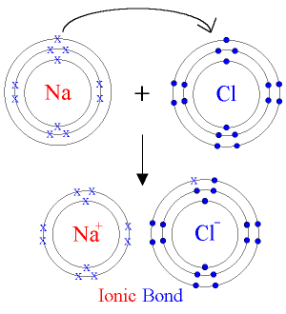

Slide 7
ionic compounds are usually crystalline solids at room temperature.
Ionic compounds have high melting and boiling points.
Ionic compounds cannot conduct electricity when solid, but do so when molten or in aqueous solution.
Ionic compounds are soluble in water.
Due to presence of ionic compound, these compounds are not volatile.
Form stable giant crystal lattices with strong forces between ions.
Properties of ionic compounds

Slide 8
Covalent Bonding
Takes place between non-metals
Elements of IV, V, VI AND VII groups form covalent bonds.
Electrons are shared but not transferred.
No ion formation.
Molecules are formed.
Definition:
Single Covalent Bond
Atoms achieve stability by sharing just one electron pair.
Two electron pairs are transferred to attain stability.
Double Covalent Bond
Attraction-to-repulsion stability that forms between atoms when they share electrons is known as covalent bonding.

Slide 9
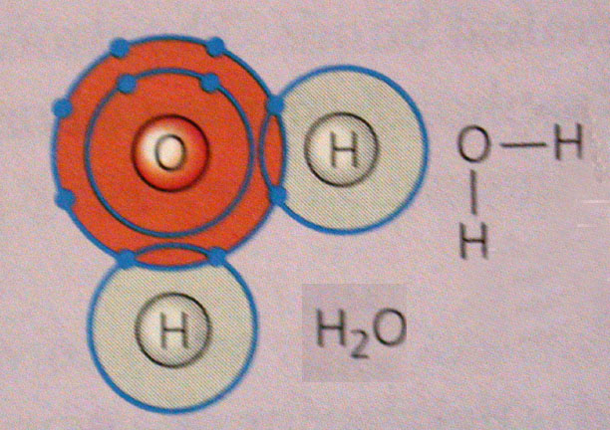
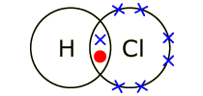
Examples
of covalent bonds
Hydrogen chloride
Hydrogen atoms and chlorine atoms can each form one covalent bond. One pair of electrons is shared in a hydrogen chloride molecule.

Slide 10
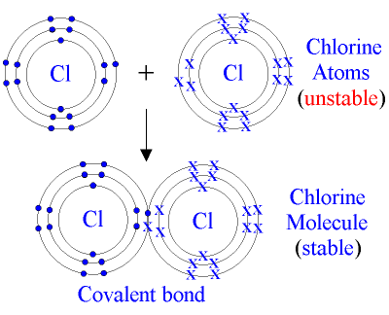
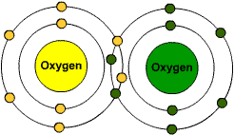
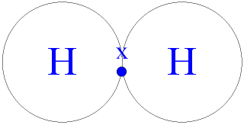
Hydrogen
H-H

Slide 11
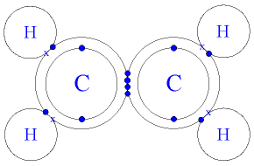
Ethene
Nitrogen

Slide 12
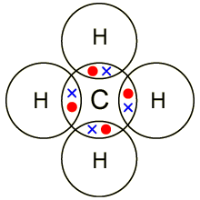
Methane
Hydrogen atoms can each form one covalent bond, while carbon atoms can each form four covalent bonds. Four pairs of electrons are shared in a methane molecule (CH₄).
Properties:
Particles are small and have electrons shared.
Covalent compounds have low melting and boiling points.
Covalent bonds between atoms are not weak but the attractive forces between molecules are weak.
Covalent compounds cannot conduct electricity in any physical state.
Covalent compounds are soluble in organic solvents but not in water.
Volatile and give off a smell when they evaporate.
Covalent Compounds

Slide 13
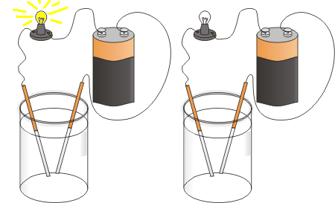
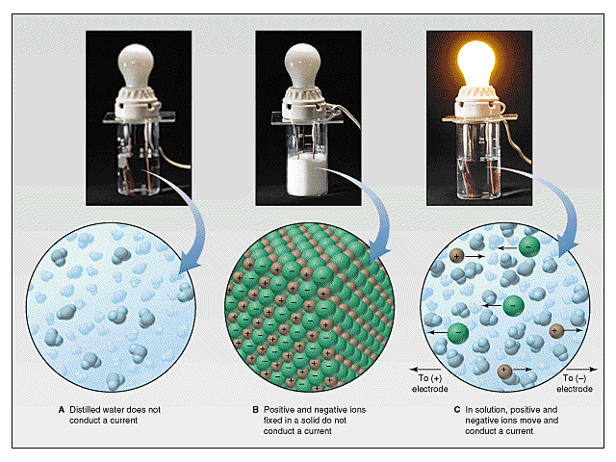
Electrical Conductivity

Slide 14
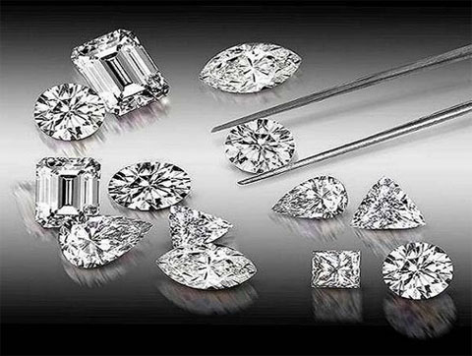
Macromolecules

Slide 15
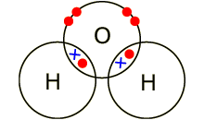
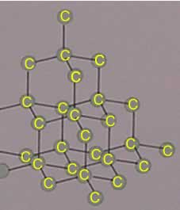
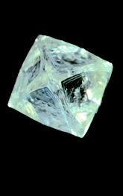
Diamond
the allotrope of carbon.
the carbon atoms are arranged in form of cubic lattice.
each carbon atom joins four other carbon atoms in regular tetrahedrons (triangular prisms).
Diamond is a crystal.
It is the hardest naturally occurring material known.
It is an efficient thermal conductor.
Highly lustrous.
High melting and boiling points.
Density is 3.5 g/cm³.

Slide 16
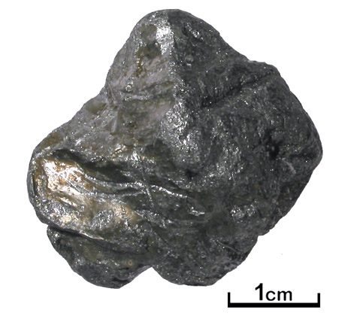
Graphite
Graphite is another allotrope of carbon.
It has a layered structure.
Each carbon atom is bonded covalently to three other carbon atoms in a hexagonal structure.
The layers are held together by weak Vander Wall’s force of attraction.
High melting and boiling points.
Good conductors of electricity.
Soft.
Density is 2.2 g/cm³.
Black, opaque and shiny solid.

Slide 17
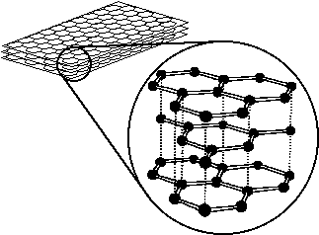

Slide 18
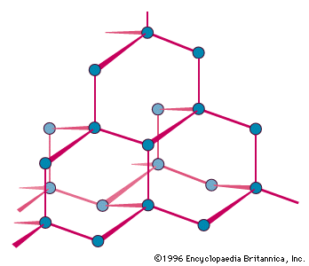
Polyethene
it is a polymer.
the monomer used in making polyethene is ethene.
it has a high melting point and doesn’t conduct electricity.
Silicon
Properties of silicon are similar to that of diamond:
Silicon is hard though not as hard as diamond.
Silicon has high melting and boiling points.
Pure silicon does not conduct electricity but becomes a semi-conductor when impregnated with impurities.

Slide 19
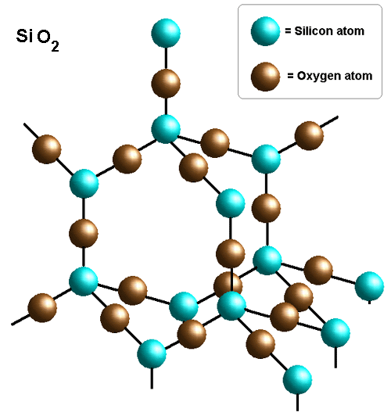
Silica
Giant molecular structure similar to diamond.
Each silicon atom is bonded to four other oxygen atoms in a tetrahedral arrangement.
Each silicon atom forms four covalent bonds to four oxygen atoms.
High melting and boiling points.
Poor conductors of electricity.
Hard, but not as hard as diamond.

Slide 20
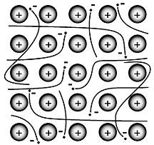
Metallic Bonding
Metals are electropositive elements with the ability to lose valence electrons.
Atoms are held by a “sea of electrons”.
these free electrons move freely among the positive metals ions arranged in a regular crystal lattice.
Properties
metals are good conductors.
metals have high melting and boiling points.

